Slide 1

Micro Processors & Interfacing
16CS307
Mr. M Krishna Chennakesava Rao,
Asst. Professor, Dept. of ECE,
VFSTR University

Slide 2
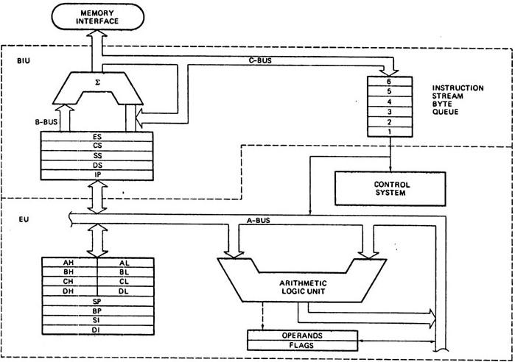
Architecture of 8086 Microprocessor
The 8086 CPU is divided into two independent functional units:
Bus Interface Unit (BIU)
Execution Unit (EU)
Ref: Hall

Slide 3
Functions of Bus Interface Unit
Architecture of 8086 Microprocessor
1. It sends address of the memory or I/O.
2. It fetches instruction from memory.
3. It reads data from port/memory.
4. It writes data into port/memory.
5. It supports instruction queuing.
6. It provides the address relocation facility.
Note:
BIU contains the circuit for physical address calculations
and
a pre-decoding instruction byte queue (6 Bytes long)

Slide 4
Architecture of 8086 Microprocessor
Instruction Queue
To increase the execution speed,
BIU fetches as many as six instruction bytes ahead to time from memory.
All six bytes are then held in first in first out ( FIFO) 6 byte register called instruction queue.
Then all bytes have to be given to EU one by one.
This pre fetching operation of BIU may be in parallel with execution operation of EU,
which improves the speed execution of the instruction.

Slide 5
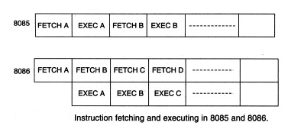
PIPELINING
Fetching the next instruction while the current instruction executes is called pipelining.
It increases the speed of operation of microprocessor 8086

Slide 6
Architecture of 8086 Microprocessor
The functions of execution unit are:
To tell BIU where to fetch the instructions or data from.
To decode the instructions.
To execute the instructions.
The EU contains the control circuitry to perform various internal operations.
A decoder in EU decodes the instruction fetched memory to generate
different internal or external control signals required to perform the operation.
EU has 16-bit ALU, which can perform arithmetic and logical operations on 8-bit
as well as 16-bit.
Execution Unit (EU)

Slide 7
Architecture of 8086 Microprocessor
Execution Unit (EU)
EU has the following functional parts these are
a). ALU
b). Register Set.
c). Operand & Flag Register.
d). Control System.

Slide 8
Architecture of 8086 Microprocessor
ALU in Execution Unit (EU)
a).ALU (Arithmetic and Logical Unit):- It performs Arithmetic and Logical operations on
8 bits/16bits. The Bit Capacity of ALU is 16bits.
It can do the following arithmetic operations :
i) Addition ii) Subtraction iii) Multiplication
iv) Division v) Increment vi) Decrement
Arithmetic operations may be performed on four types of numbers
Unsigned binary numbers Signed binary numbers (Integers)
Unsigned packed decimal numbers Unsigned unpacked decimal numbers
The ALU can also perform logical operations such as
NOT ii) AND iii) OR iv) EX-OR v) TEST vi) Logical Shift
vii) Arithmetic Shift viii) Circular Shift (or) Rotate

Slide 9
Architecture of 8086 Microprocessor
Control Unit & Registers in Execution Unit (EU)
b). Control System: - It is divided into 2 parts. They are
Decoding circuit----it decodes the instruction.
Timing circuit---- it generates control signals at appropriate times.
c). Register Set:- It is used to hold the 16-bit information.
The information is address, data or result of some operation.
d). Operand & Flag Register: -
Operand holds the result produced by ALU.
Flags are also called as PSW (program status word) of 8086.
Each single bit is called flag.

